Slide 1
MCP Summer Workshop
Beginner’s C++ Tutorial
Follow along with us!

Slide 2
Table of contents
01
02
03
04
What’s programming all about?
Quickly setting up an environment
Introduction to C++
Getting started with writing code
Input/Output; Vars; Math, Loops, Branches
Assorted Challenges
The absolute basics of C++
Hands on examples! :0

Slide 3
01
Why do we create code?
Coming back to this soon…

Slide 4

What are some things that code can accomplish?
i.e… moving robots?
create websites?
make phone games
any other examples?
Notes:
image source: https://www.eduauraa.com/blog/how-to-become-a-programmer-in-india

Slide 5
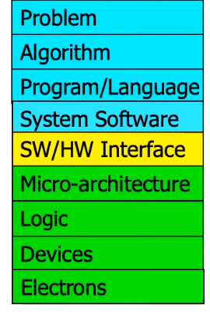

So what is a program?
(Ignore the colours)
Notes:
image source: https://www.hp.com/us-en/shop/tech-takes/best-coding-programs
Onur Mutlu’s Digital Design and Computer Architecture - Lecture 1: Introduction and Basics (Spring 2023)

Slide 6
What is the purpose of programming?
Back to the main point…
Notes:
image source: https://www.hp.com/us-en/shop/tech-takes/best-coding-programs
Onur Mutlu’s Digital Design and Computer Architecture - Lecture 1: Introduction and Basics (Spring 2023)

Slide 7
02
Setting Up Your Environment
Very complicated.

Slide 8
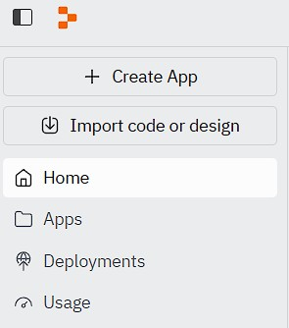
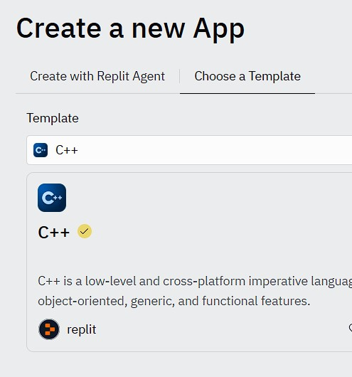
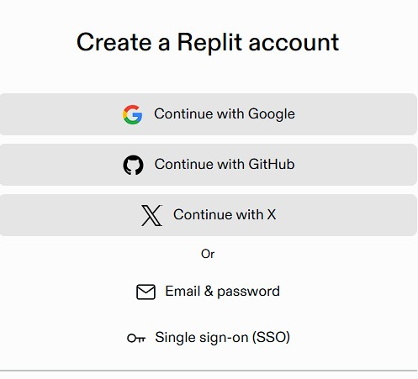
Online IDE: Replit
Sign Up for Replit
Click Create App
Select the C++ Template

Slide 9
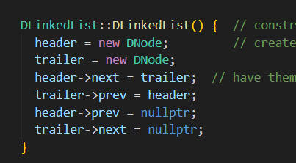
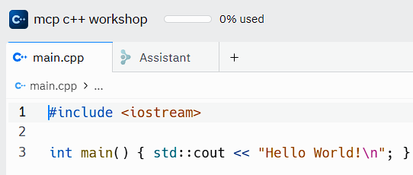
IDEs
Code Editor, similar to a text editor
Compiler or Interpreter
Debugger
Build Tools
File/Project Management
Replit offers a cloud based solution
Convenient for small scale projects
OnlineGDB is also an option
We Recommend VScode for larger projects

Slide 10
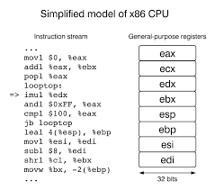
C++ Under the Hood
1.
2.
3.
Source File
Compiler
When you write C++ code, you’re giving the computer instructions in a language it doesn’t fully understand yet. It needs to translate those instructions into something it can actually run — and that’s where compiling comes in.
The compiler takes your .cpp file and translates it into machine code (binary — 0s and 1s).
Executable File
To finally execute your program, you must run the executable file which your computer can use.
Notes:
https://www.nayuki.io/page/a-fundamental-introduction-to-x86-assembly-programming

Slide 11
03
Simple C++
Introducing the basic instructions

Slide 12
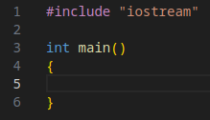
Necessities of a C++ Program
Every program has two necessary parts.
IO -> Input + Output
int main()
(Basically every program)

Slide 13
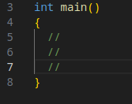
int main()
Think of it as a starting line: it tells the computer where to start following your instructions.

Slide 14
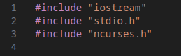
Input and Output
Think about it: why does every program need to have some form of output?
Meanwhile, is input necessary for all programs?

Slide 15
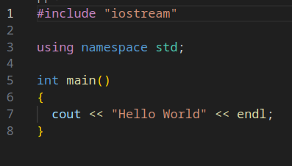
The First Instruction
Most common 'first program' that people learn; still, there's a lot going on.
Where do the words, "Hello World", actually show up?
Notes:
character

Slide 16
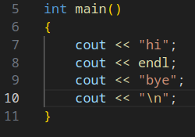
Special Output Newline
When you want to separate outputs by a new line, there are two separate methods. Keep this in mind!

Slide 17
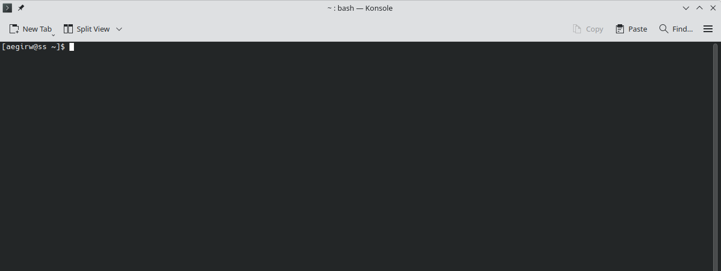
The Console
A magic mirror.
Write on it, and you shall receive your response…
Fun Fact:
Early “Personal Computers” were much simpler than what we have today. Computer Monitors were limited to a simple ANSI Text display, along with a keyboard for input.
This changed in the 1980’s, where GUI’s (Graphical User Interfaces) were released, developed into the modernized displays of today.

Slide 18
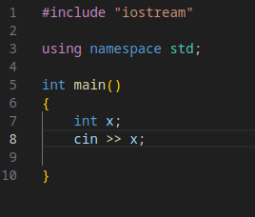
The Complimentary to 'cout'
Now what happens… Nothing!
We have to tell the program what to do with our input first.
What does 'cin' stand for? Does anybody know?

Slide 19
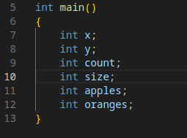
Integers
But wait, what does "int x" mean?
It's the most fundamental method of storing a piece of information… in this case, an integer value.

Slide 20
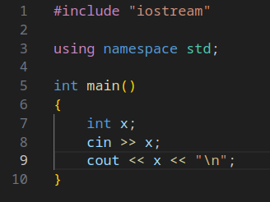
Recording an Integer
Nothing fancy.

Slide 21
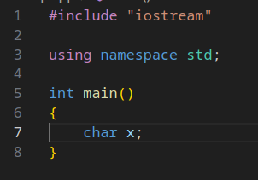
What About.. Characters?
Letters of the alphabet.

Slide 22
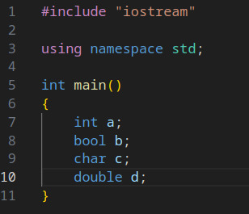
Four Fundamental Types
int -> stores an integer value
bool -> stores a boolean value
char -> stores a character value
float/double -> stores a real value
We won’t be focusing on reals today! Don’t worry about them for now.

Slide 23
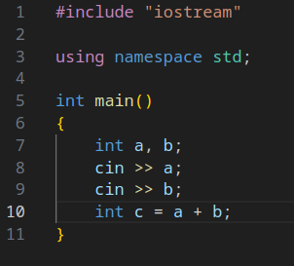
What to do with an integer
Middle school algebra. And the assignment operator.
The equals sign sets the value of ‘c’ to “a + b”.

Slide 24
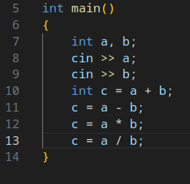
Other Basic Operations
Probably you’ve seen these symbols before.

Slide 25
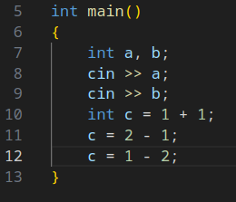
Actual Math
You can use numbers too! Calculations aren’t limited to your previous variables.

Slide 26
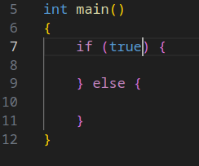
The Most Important Concept Today
Making decisions.

Slide 27
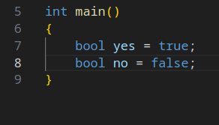
What’s a Boolean?
Named after George Boole who introduced the field of boolean algebra.
A bool can only have two values: true or false. There is no other state.

Slide 28
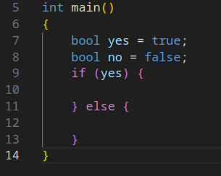
Branches
A program is essentially a plan. We want to plan ahead for any possible changes in this plan to make our program fail-proof.

Slide 29
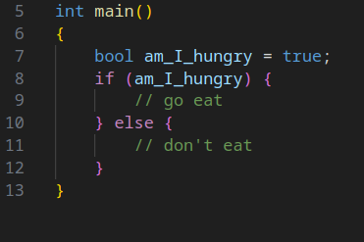
What Decisions Can We Make
Something I think about many times throughout the day.

Slide 30
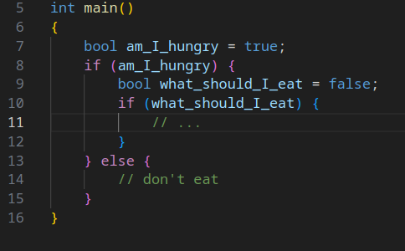
Not Everything is Yes or No
A burger? A pie? Some french fries?
True or false doesn’t always cut it; we need to think of different ways to ask our question.

Slide 31
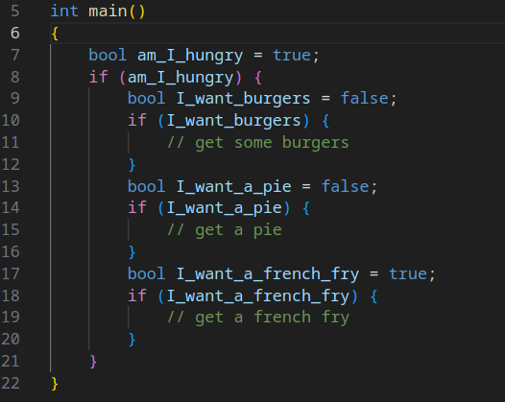
Making Multiple Decisions
‘if’ blocks can be chained together.

Slide 32
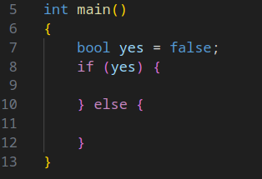
Preparing For the Worst
What if our initial condition isn’t true? What happens then?
Our trusty ‘else’ block!

Slide 33
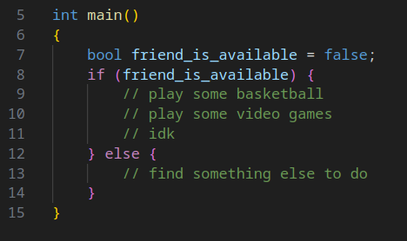
What Decisions Can We Make 2
Know that if you have a conditional, you’ll have to account for both true and false options.

Slide 34
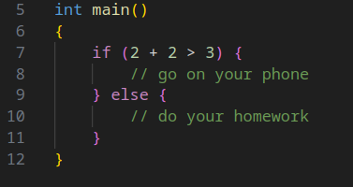
Mathematic Conditionals
Sometimes you can’t read the user’s mind! You’ll then have to figure out yourself what to do next.

Slide 35
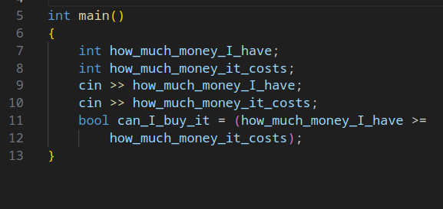
Simple AI
For when you’re really tired and don’t want to think.
Lines 11 and 12 are separated for readability :)

Slide 36
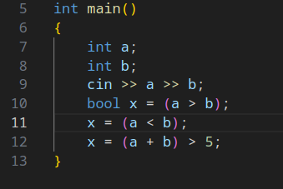
Other Forms of Conditionals
Less than, more than, less than or equal to, more than or equal to. There are many possible conditionals you can put in an if statement.

Slide 37
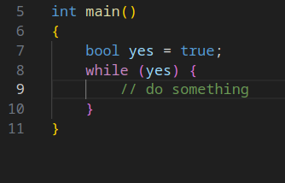
Loops!
There are two types of loops; we’ll cover ‘while’ loops today.
The other type takes longer to type.

Slide 38
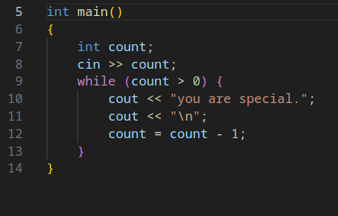
Cheering Up One’s Self
Let’s analyse this program together!
A variable on the left hand side can refer to itself on the right hand side.

Slide 39
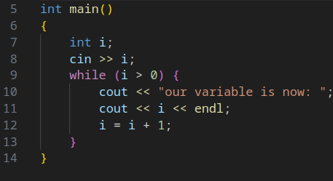
Will this Loop Ever End?
Be careful writing your loop conditions!

Slide 40
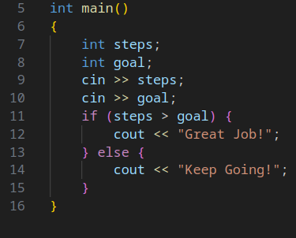
What Have We Learned?
In essence, I’ve gone through the three fundamental parts of a computer program.
1. Store and retrieve information
2. Gather and create new information
3. Make decisions
Notes:
Now you have to learn how to use them!

Slide 41
That’s All of the Basics
All you needed to know.. for now...
Next up: our challenge problems!

Slide 42
04
Some Practical Exercises
Make sure you try them out yourself!

Slide 43
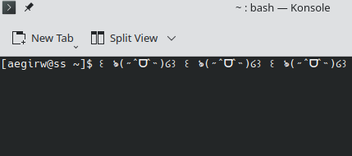
Problem Title
Problem Description.
A paragraph explaining the problem will be shown here. Read through it carefully!
Expected Input/Output
What the program’s input/output should look like when your code is correct.

Slide 44
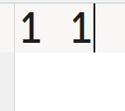
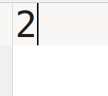
Adding Two Numbers
Your task is simple: receive two integers from the user and add them.
Input: two integers, separated by a space.
Output: the sum of the two integers
Input:
Output:

Slide 45
Solution 1

Slide 46
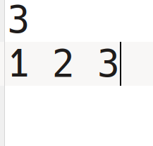
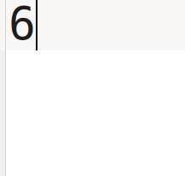
Adding N Numbers
The user will give you a number. Then, they will give you a list of that size of integers. Your task is to add them all and return the sum.
Input: The first line will contain N, where N is the size of the list of numbers. The second line will contain that list of numbers.
Output: The sum of these numbers
Input
Output

Slide 47
Solution 2

Slide 48
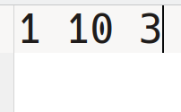
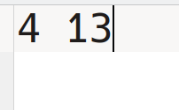
Min-Max Sum
Given three numbers, find the minimum and maximum sum after choosing two of three numbers.
For example, given the three numbers
[2, 4, 6], the maximum sum would be 10, and the minimum sum would be 6.
Input: three positive integers
Output: the minimum sum, then the maximum sum.
Input:
Output:

Slide 49
Solution 3

Slide 50
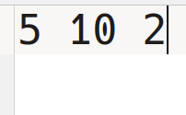
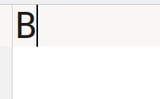
Maximizing Ice Cream
It’s a hot summer day out, and you currently have ‘A’ ice cream cones. A suspicious man comes up to you and offers you two choices; the first is to receive ‘B’ extra ice cream cones, and the second is to multiply your current number of ice cream cones by ‘C’. Which choice maximizes your ice cream cones?
Input: three integers, A, B, and C
Output: B or C depending on the better choice
Input:
Output:
Notes:
What if both choices are equal?

Slide 51
Solution 4

Slide 52
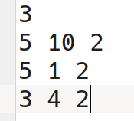
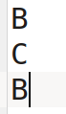
Maximizing Ice Cream 2
Now, you'll have to solve the problem more than once. The input will start with a number 'N', and you'll receive the three previous integers 'N' number of times.
Input: the number N. Then, on 'N' lines, you'll receive three integers, A, B, and C.
Output: B or C depending on the better choice, for each of the 'N' inputs.
Input:
Output:

Slide 53
Solution 5

Slide 54
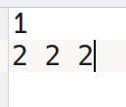
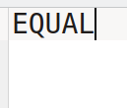
Maximizing Ice Cream 3
What if both choices give the same number of ice creams? We want to deal with the special case!
Input: the number N. Then, on 'N' lines, you'll receive three integers, A, B, and C.
Output: B or C depending on the better choice for each of the 'N' inputs. In the case that both choices give equal benefits, output the word "EQUAL".
Input:
Output:

Slide 55
Solution 6

Slide 56

@maccpteam on Instagram
:)

